Slide 1
Introduction of PHP

Slide 2
Understanding Web Architecture
Presentation Layer/Application Layer
Logic Layer
Physical Layer

Slide 3
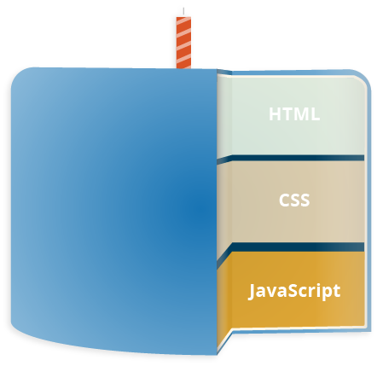




Presentation Layer/ Application Layer
Web Browser
Web
User Interface
Web Service Client

Slide 4
Logic Layer The Client-server programming langauge
PHP
PYTHON
JAVA
ASP .NET

Slide 5



Physical Layer
Database
Oracle DB
No SQL
MYSQL

Slide 6
Flows
Database
Web Browser
Client-Server Scripting Languages
(PHP)
http request
http response

Slide 7
Let’s talk about PHP
You would need to have basic understanding on following programming languages:-
HTML
CSS
JAVASCRIPT

Slide 8
Let do exercise
Build a webpage using PHP, HTML, CSS, JAVASCRIPT

